Slide 1
Modern Web Technologies Week 4 – Routing, Promises. Async await
Instructor: Harman Mann

Slide 2
Last week
Getting started with express
Handing routing with express
Using GET and POST
Post Man

Slide 3
Agenda
Callbacks
Promises
Async-await
Middleware

Slide 4
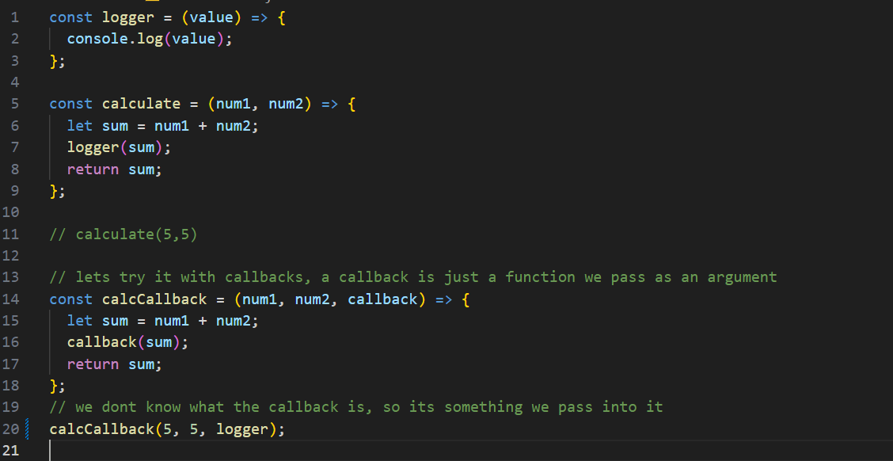
Example: Callback

Slide 5
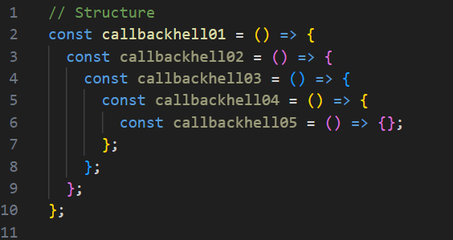
Callback Hell
Essentially a bunch of nested callback functions

Slide 6
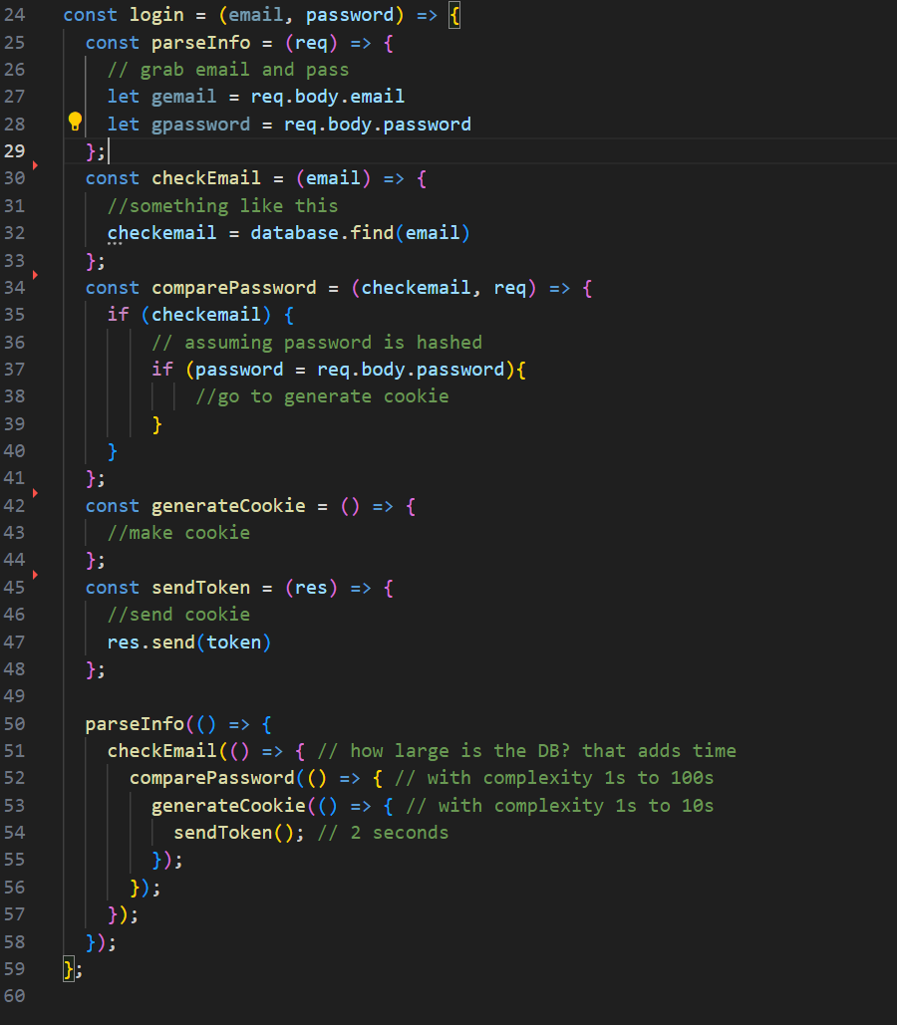
Callback Hell Example
So, How do we fix this? - Promises

Slide 7
Promises
Promises contain both the “producing code” and the “consuming code”
Producing code obtains results
Consuming code waits for producing code to finish
Result can be success or error
Has resolve and reject functions as callbacks
Can contain synchronous or asynchronous code inside promise
(Remember using React, Remember fetching, then response.json, then data)

Slide 8
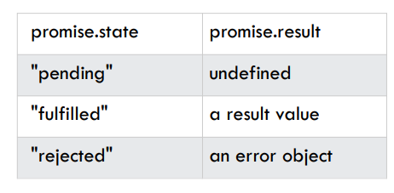
promises

Slide 9
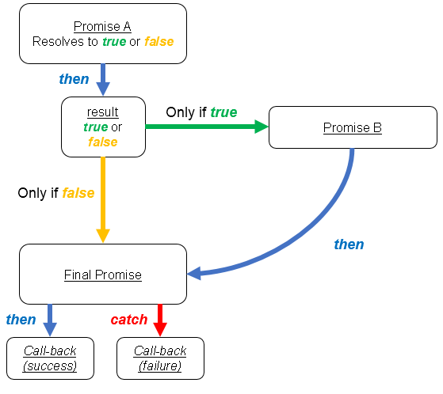
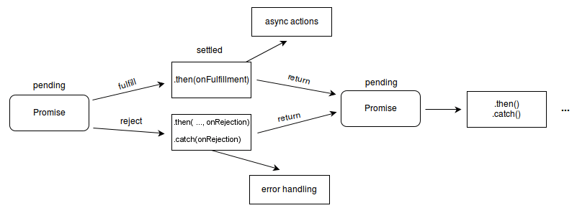
Promises
Promises contain both the “producing code” and the “consuming code”
Producing code obtains results
Consuming code waits for producing code to finish
Result can be success or error
Has resolve and reject functions as callbacks
Can contain synchronous or asynchronous code inside promise

Slide 10
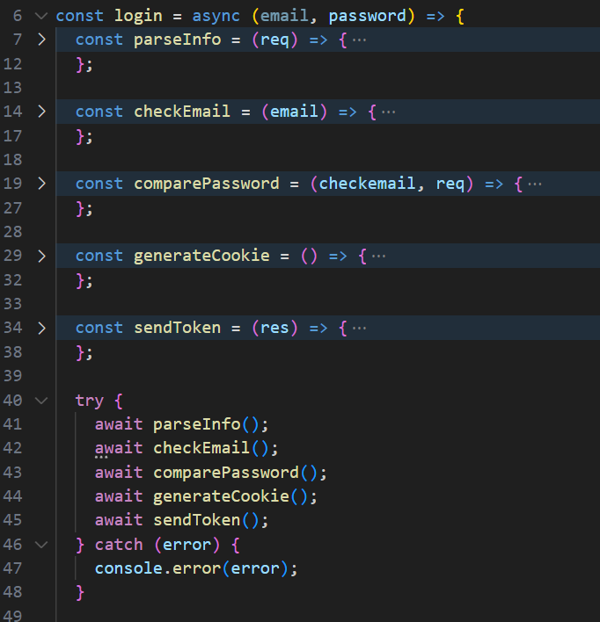
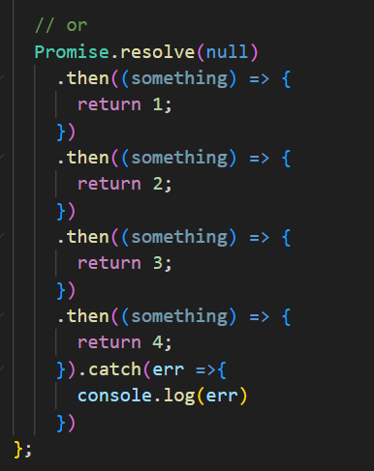
Examples of Promises:

Slide 11
Will we use Promises in class? - Yes
We will be communicating with our server and database
We will request data from our hard drives and our database
We don’t want to stop operations while searching for information
I will provide some examples in the following weeks
Reading files and directories -> week 5
Databases -> after reading week

Slide 12
Aysnc-Await
Declaring a function async will wrap the return inside a promise
Code continues execution immediately
Promise must be resolved to get the value by using .then or await

Slide 13
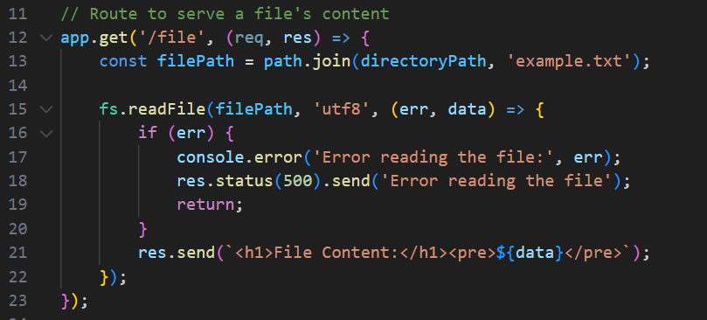
Example Async

Slide 14
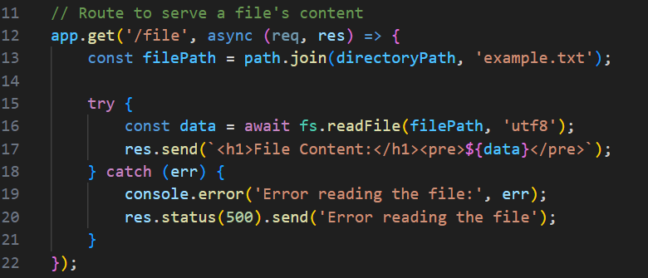

Slide 15
Example Async

Slide 16
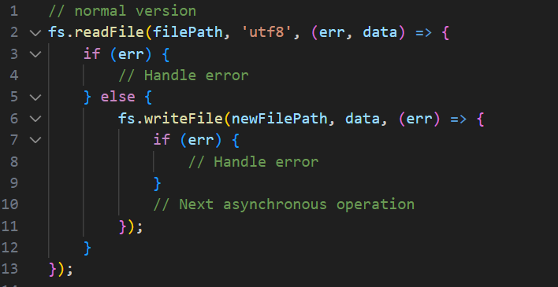
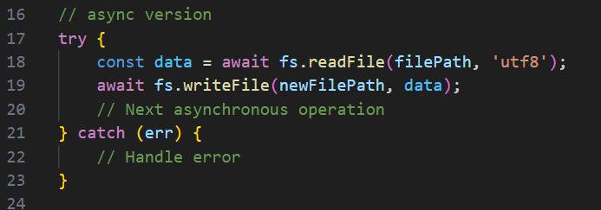
Comparing the skeletons of the functions

Slide 17
So, Middleware in express
Middleware in Express refers to functions that can execute in the ‘middle’ of a request/response cycle typically before a matching route function is executed.
Middleware functions are functions that have access to the request object (req), the response object (res), and the next() function in the application’s request-response cycle.
The next() function is a function in the Express router which, when invoked, executes the middleware succeeding the current middleware

Slide 18
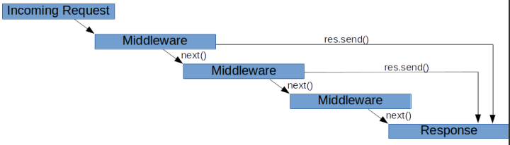
Middleware Order is Important
When a request is received by Express, each middleware that matches the request is run in the order it is initialized until there is a terminating action (like a response being sent)

Slide 19
Let's try making some middleware
Let's try making a quick little logger function
When someone hits a request
Write the route, the method and the time they tried to access the endpoint
This will go back to making our own module and how we can use it in express

Slide 20
Logger function inside 1 route
Moving into Code, Screenshots will be on the end of

Slide 21
Moving onto the next topic: Async and Await
The idea is simply
I will start doing this
You continue handling another operation
IRL i.e: I will start the lecture while doing attendance
I will pass the operation onto you while I go through the lecture, making attendance asynchronous
In our class:
Our server needs to be able to handle multiple interactions
Sending webpages, parsing data, confirming logins, checking databases
We don’t want to bottleneck our operations from those operations taking time

Slide 22
Callbacks
Functions are executed in the sequence they are called. Not in the sequence they are defined
Callbacks give us greater control over the sequence of execution
Very useful in asynchronous functions
Fundamental component of JavaScript
Do not use parentheses when passing callback

